Slide 1

Organic Phosphorus and Carbamate Pesticides
Matthew P. Davey, MD
Oregon Health and Science University
Notes:
Good morning, my name is Matt Davey, I’m current a 2nd year fellow at OHSU in Portland, Oregon with Gillian, and Rob. This morning i want to take our time together and talk about both organophosphate and carbamate pesticides. Now obviously, we live in different places and our patients are exposed to many different pesticides and so if there are unique ones or you have anecdotes we would love to hear them.

Slide 2
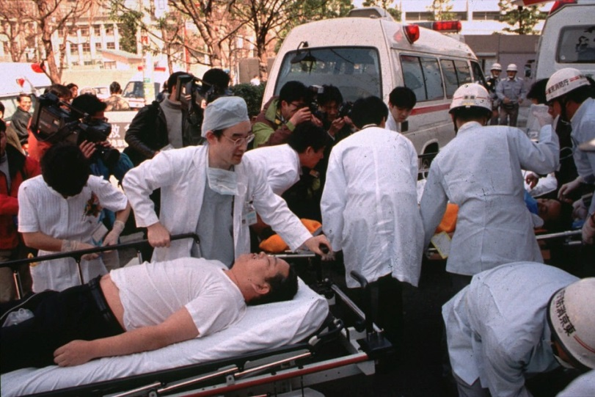
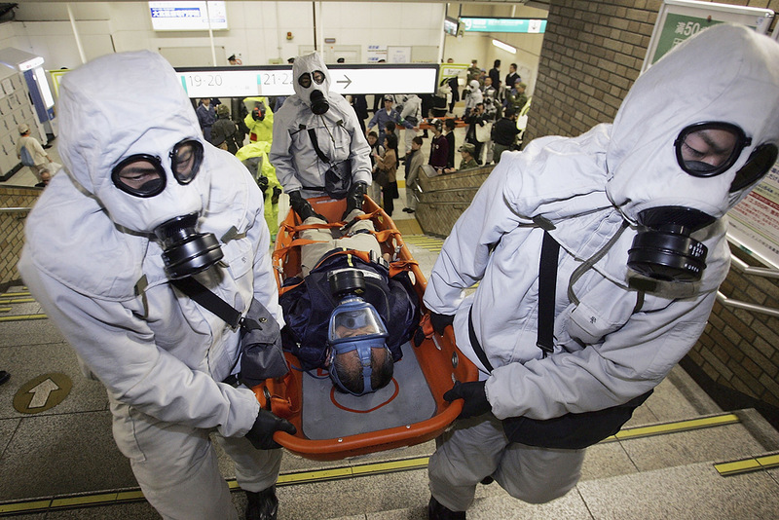
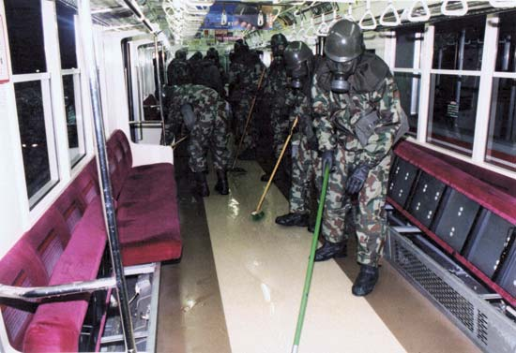
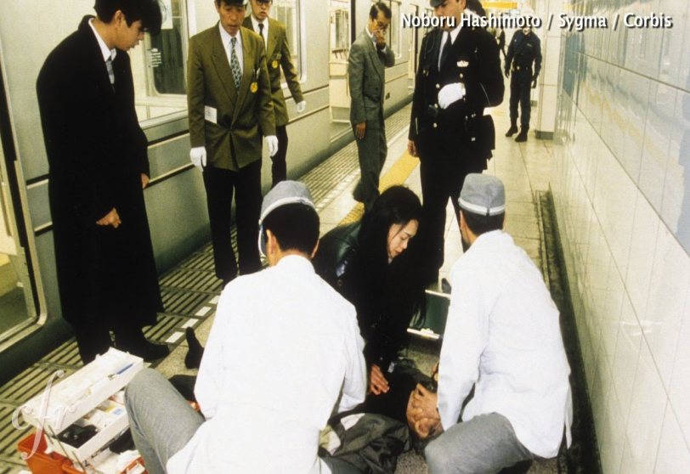
Tokyo Sarin Attack
Notes:
Here is the first tox disaster that I’ll talk about. Most of you may recognize this as the Tokyo Sarin Attacks of 1995. Sarin gas was punctured and released onto several different subway lines, leading to thousands of being exposed. Most had visual complaints, but obviously there were many that were severely injured and ultimately there were 12 deaths. As we’ve heard already most patients presented via a non-EMS route. These franticed pictures should get us thinking what we would do in that scenario and what the workup and management of these patients should be whether we are faced with a large exposure to a nerve agent or a farmer who has ingested malathion.

Slide 3
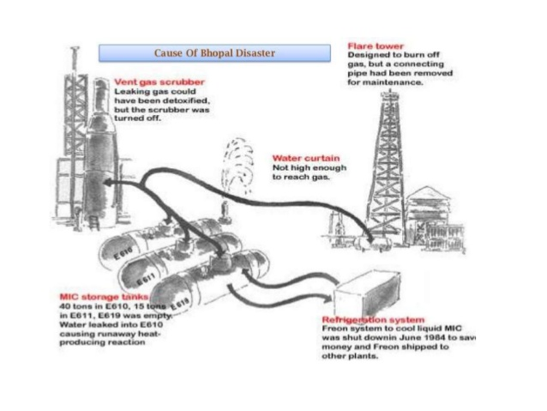
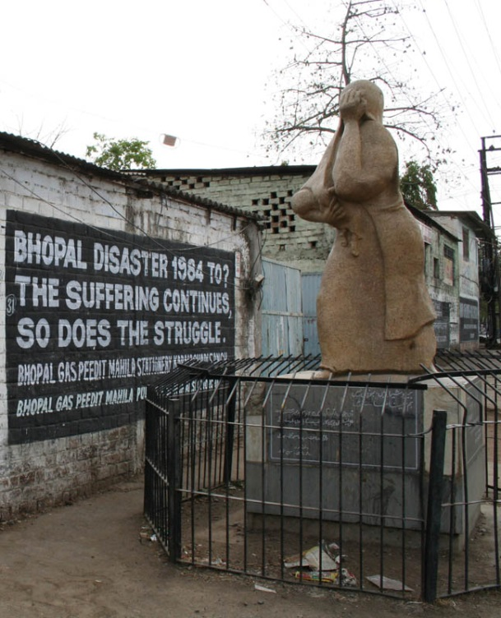
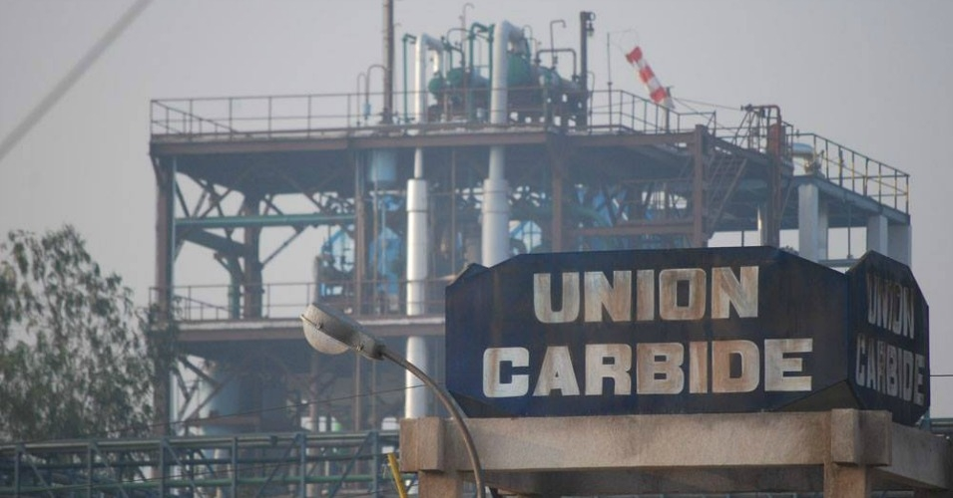
Bhopal Union Carbide Disaster
Notes:
The next tox disaster that I’ll highlight was in Bhopal, India at the Union Carbide Plant in 1984. While the Union Carbide plant was well know to manufacture the carbamate carbaryl. However, the explosion and subsequent gas cloud was made up of mainly methyisocyanate, which is an pulmonary irritant, and in this case lead to the exposure of close to ½ million people. The carbamate itself was not thought to be directly acting in this disaster.

Slide 4
The Problem
Pesticide poisoning kills approximately 300,000 people worldwide every year
Mortality can be as high as 70% in developing countries
  Lack of hospital services in the vicinity
  Inadequate transport
  Increased patient to care giver ratio
  Non-availability of definitive antidote
  Lack of ventilators
    3000 to 6000 ventilators constantly required in Asia for ventilation of poisoned patients
Notes:
Here we can see that the problem of organophosphates and other pesticides, is a worldwide problem, with an approximate 300,000 per year death rate worldwide. The mortality really depends on your local resources. Oftentimes in more rural settings with limited local hospitals and difficulty in getting people to hospitals in a timely manner leads to a very high mortality rate. This usually occurs out of the hospital. For those that make it to the hospital, they can take up an enormous amount of resources with the main problem being the lack of available ventilators and respiratory support. Here one statistic being that 3000 to 6000 ventilators in constant use in Asia on poisoned patients.

Slide 5
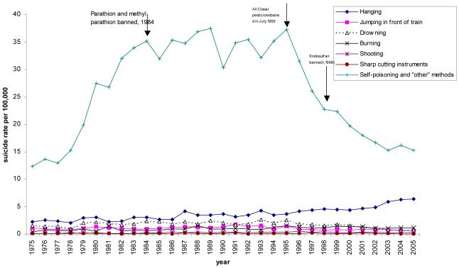
One Simple Solution
Int J Epidemiol. 2007;36(6):1235-1242
Notes:
Here you can see one possible solution to the problem. The graph shows suicide rates in Sri Lanka, staring in 1975, going through 2005. The blue line shows the rate of suicide by self-poisoning. You can see in 1984, parathion was banned. And then in 1995, all class 1 pesticides were banned, with a subsequent large decrease in the self-poisoning rate – which cut the rate in half – so regulating these pesticides does impact public health. You can see the other forms of suicide on the bottom, pales in comparison to self poisonings.

Slide 6
Pesticide Classification
WHO Recommended Classification of Pesticides by Hazard; 2009
Notes:
Speaking of class 1 pesticides, the WHO has this classification scheme for pesticides. They are classified based on their potency and their LD50 in rats. The do break them into oral and dermal exposure, and classify them from extremely hazardous to unlikely to present acute hazard.

Slide 7
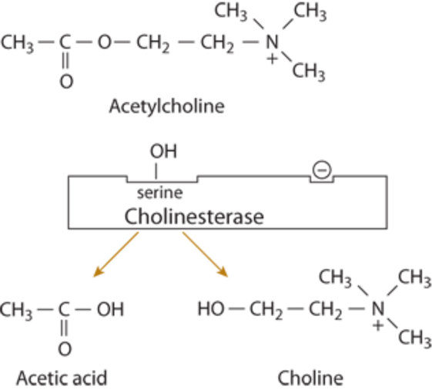
How it is supposed to work
Goldfrank’s Toxicologic Emergencies; 2014
Notes:
So here you see the basis for organophosphate toxicity. On the left we can see what would be either a nicotinic receptor at the neuromuscular junction or a muscarinic acetylcholine receptor. As the signal is transmitted, acetylcholine is released and stimulates the acetylcholine receptor. After this the acetylcholine is metabolized by acetylcholinesterase and then is reuptaken into the releasing nerve terminal. On the right you see the metabolism through the cholinesterase. Acetylcholine is metabolized to acetic acid and choline which is then recycled.

Slide 8
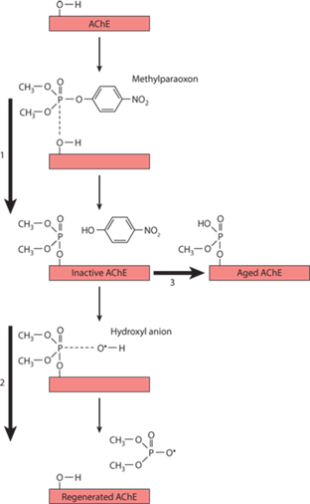
How it goes wrong
Organophosphate binds to the AChE
Inability to metabolize acetylcholine leads to a cholinergic crisis
T_{1/2} of reaction depends on the leaving group
When the alkyl group is lost the bond is “aged”
  AChE can longer be regenerated
Goldfrank’s Toxicologic Emergencies; 2014
Notes:
Here we see what goes wrong with organophosphates and carbamates. The OP binds to the acetylcholinesterase, greatly increasing the amount of acetylcholine. You can see here the leaving group being cleaved off. This leaving group helps to determine the t1/2 life of inhibition. The next step of the process is when one of the alkyl groups is lost and then the bond with the OP and acetylcholinesterase enzyme is “aged” and cannot be regenerated. Carbamates do not undergo ageing. They are spontaneously hydrolyzed to regenerate the active acetylcholinesterase.

Slide 9
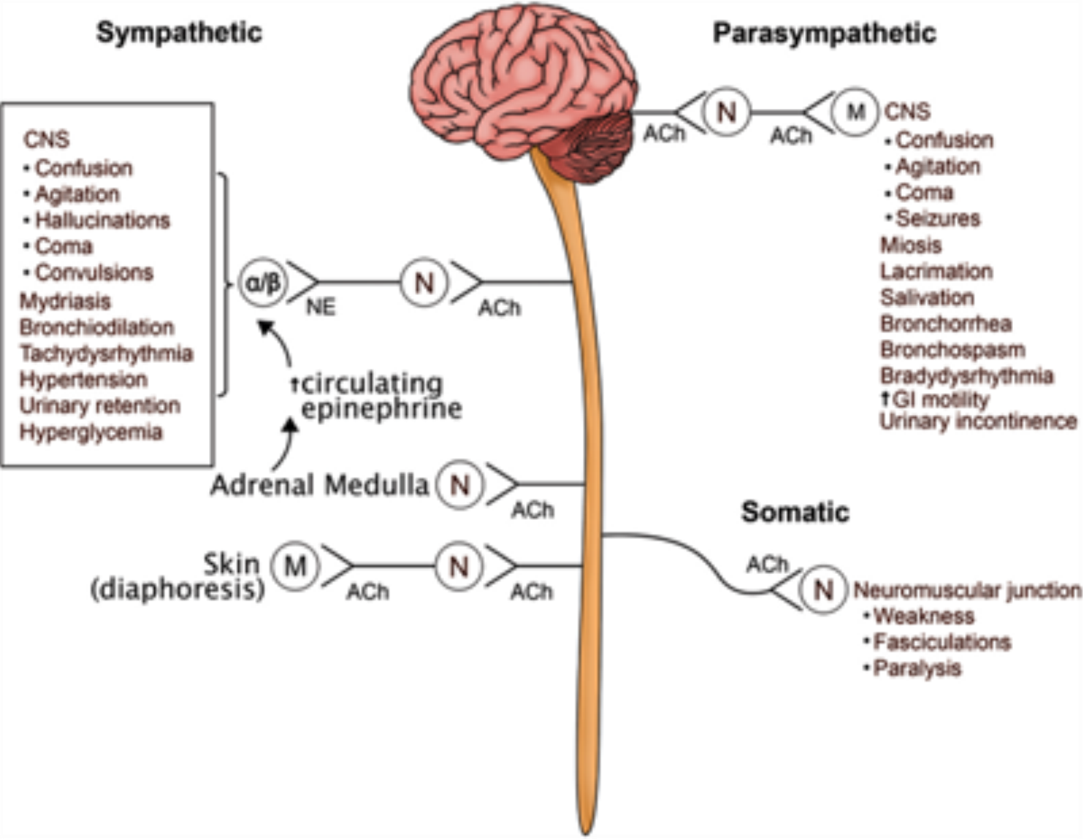
Clinical Translation
Notes:
Now as acetylcholine builds up in the synapse, there will be excitation at all the nicotinic and muscarinic receptors. Here you can see that leads to both sympathetic and parasympathetic symptoms. Because of this, initially you may see some overlap of the autonomic toxicities, with somebody having mydriasis and tachycardia, but also diaphoresis, urinary incontinence and weakness.

Slide 10
Classic Severe Organophosphate Toxicity
Unresponsive
Pinpoint pupils
Muscle fasciculations
Diaphoresis
Emesis and diarrhea
Salivation, lacrimation
Urinary incontinence
Odor of garlic or solvents
Kloss. Toxicology in a Box; 2013.
Notes:
But here is what a classic organophosphate toxic patient will look like. Classically, they are overwhelmingly cholinergic, with the patient with pinpoint pupils, diaphoresis, vomiting and diarrhea, and muscle fasciculations and eventual paralysis from the stimulation at the neuromuscular junction. In the case of ingestion or dermal exposure, they or their clothes can smell of garlic or that or other solvents.

Slide 11
However…
Less severe poisoning may not be typical
Symptoms may also depend on:
  Route
  Degree of exposure
  Particular organophosphate
Notes:
The symptoms, however, may not be that classic or typical, especially depending on what they were actually exposed to, for how long, and whether it was an inhalation, dermal, or oral ingestion.

Slide 12
Specific Findings
Central Nervous System
  Can be nonspecific:
    Anxiety, restlessness, insomnia, depression
    Headache, dizziness
    Blurred vision
    Tremor
  Seizures actually uncommon (except for nerve agents)
    May be complication of resultant hypoxia
Notes:
Neurologically, the symptoms can be quite nonspecific, and again, greatly depend on the amount and duration of exposure. Oftentimes, without a better history, these can be attributed to another cause. CNS-wise, you can see anxiety or restlessness, along with headache and dizziness. Blurred vision is likely from the inability to accomodate, and tremor possibly from the increased neuromuscular junction activity. It is interesting to note that seizures are actually relatively uncommon with OP pesticides, and its actually usually from the concominant hypoxia and not from a direct effect of the pesticide..

Slide 13
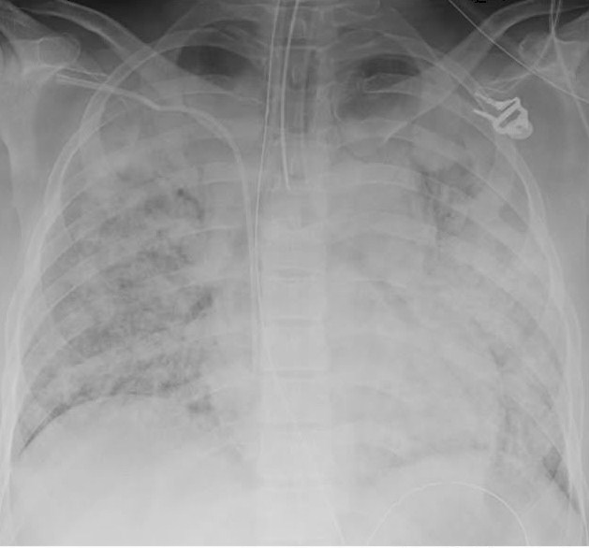
Respiratory Complications
Killer B’s: bronchorrhea and bronchoconstriction
AND
Neuromuscular junction failure at diaphragm, intercostal muscles
AND
Loss of central respiratory drive
Notes:
The real drivers of mortality can be summed up by the killer B’s: namely bronchorrhea, bronchoconstriction, and then bradycardia Here you can see in the radiograph a classic picture of bronchorrhea and pulmonary edema. The cholinergic stimulation is literally pouring bronchial and pulmonary secretions into the airway, so much so that it causes hypoxia and respiratory failure. On top of that, the overstimulation of the neuromuscular junction is not too different than the mechanism of succinylcholine that we give for intubation. There is initial increased muscle activity or fasciculations, closely followed by paralysis and respiratory arrest. And finally, OPs have been noted to also cause a loss of respiratory drive, likely from the co-administered hydrocarbons and solvents, but none-the-less, does not help the already struggling respiratory system.

Slide 14
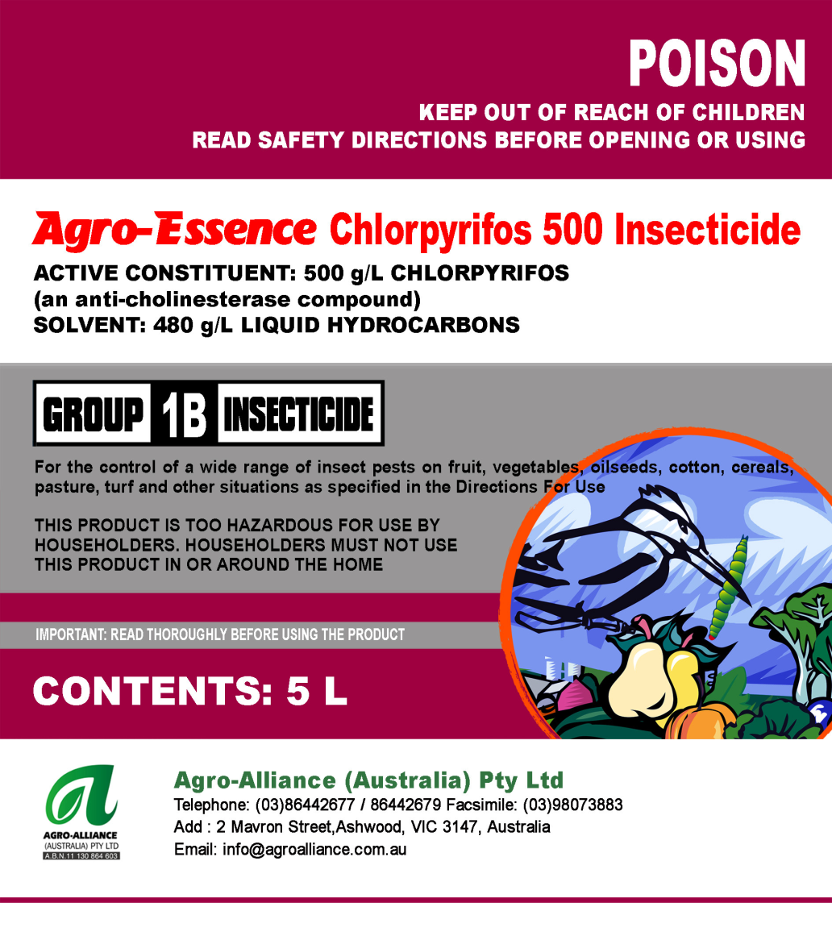
Co-formulants
Can cause toxicity prior to organophosphate effect
usually various hydrocarbon solvents
  Typically 40% xylene
  Cyclohexanone
  Surfactant
Can cause rapid loss of consciousness, respiratory arrest, aspiration pneumonitis
More on these in another lecture
Notes:
And here we can see some of those co-formulants in use with the organophosphates. We will talk about hydrocarbons and solvents in a future lecture, but their effect is much more rapid than the organophosphate and can lead to very rapid loss of consciousness, CNS depression, respiratory depression and an aspiration pneumonitis. Xylene is the hydrocarbon most often found as a solvent, cyclohexanone and surfactant are also used commonly. Here you can see a label for chlorpyrifos labeling an unknown hydrocarbon mixture as their solvent.

Slide 15
A Few Key Points on Toxicokinetics
Absorption
  Very well absorbed
  Lungs with inhalation or aspiration
  Gastrointestinal
  Mucous membranes and conjunctiva
  Dermal
    Difficult to remove compounds from the skin and clothing
Notes:
Now, while nobody really likes to hear or read about pharmacokinetics, I do think there are several really key points that should be mentioned about organophosphates that may help you take care of your next patient. In terms of absorption, they are very well absorbed via all routes. Pulmonary-wise this can be through inhalation or after a aspiration pneumonitis. Clearly they are well absorbed through the GI tract, but also very well dermally. And thus it is paramount to remove all clothing immediately and have the patient undergo dermal decontamination as soon as possible to limit ongoing absorption

Slide 16
A Few Key Points on Toxicokinetics
Distribution
  Lipophilic
  Large volume of distribution
  stored in fat
  High octanol/water coefficient
Can redistribute from fat and cause delayed toxicity <24hours later!
Notes:
In terms of distribution, it is important to know that as a class, organophosphates are very lipophilic. And thus they have a large apparent volume of distribution and are consequently are stored in fat rather in the blood compartment. For the most part, they have a very high octanol to water coefficient, which simply means that if you were to place them in a mixture of octanol and water, they would be found much more in the lipophilic octanol. And because of this, the can actually be stored away from metabolism in the fat, and then redistributed and go on to cause delayed toxicity. We will talk more about this in a little bit.

Slide 17
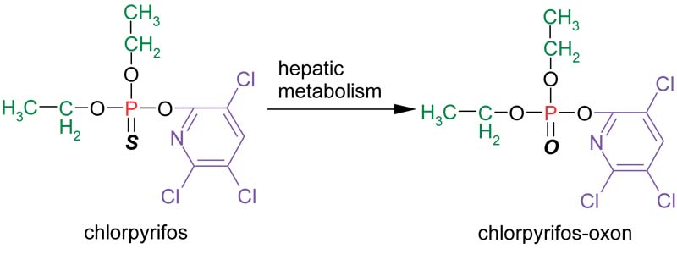
A Few Key Points on Toxicokinetics
Metabolism
  “-oxons” (ie. paraoxon) are active drug
  “-thions” (ie. malathion) are prodrug and require CYP450 metabolism
Slow conversion to active drug can cause delayed onset of symptoms
Notes:
In terms of metabolism, it is important to know that some organophosphates are found as the parent drugs and others are prodrugs needing metabolism. Any compound with the suffixe -oxon is an active drug and should theoretically have a quick time to onset. The -thions however, require CYP metabolism to become active. Here you can see the activation of chlorpyrifos to the active chlorpyrifos-oxon. The delay in conversion to the active compound may lead to a delay to toxicity and is important to note in the history.

Slide 18
Chronic Toxicity
Most common in workers with regular contact with OPs
Chronic use of cholinergic ophthalmic preparations
Vague neuro complaints: weakness, blurred vision, vomiting, diaphoresis
??association with Parkinson disease
Notes:
So now that we have a little better information on the acute presentation and some of the toxicokinetics, let’s discuss some of the effects from chronic exposure. As you can imagine, this happens most often with workers regularly coming into contact with the organophosphates. However, there have also been several reports of people using cholinergic eyedrops who have also developed chronic toxicity. The symptoms, though, are often quite vague and difficult to parse out from other nonspecific entities. They include weakness, blurred vision, and other mild cholinergic signs and symptoms. There has been a few associations with chronic OP toxicity and Parkison disease, but there is no direct causative evidence at this time.

Slide 19
Delayed Syndromes
Intermediate syndrome
  Proximal muscle weakness
    Neck flexors then diaphragm, intercostals
  Onset 24-96hours after poisoning and after cholinergic crisis resolution
  Usually resolves in 5 to 18 days
Notes:
Now those are more symptoms of ongoing low grade toxicity. However, there are other also other delayed or more subacute presentations after an acute exposure. The first being an entity called intermediate syndrome. As the name implies, it comes on after 24 to 96 hours after the initial poisoning and after the resolution of the cholinergic crisis. It usually starts as a proximal muscle weakness, namely the neck flexors, but then can descend into the muscles of respiration. It can require mechanical ventilation or reintubation, and can last for up to 18 days.

Slide 20
Potential Intermediate Syndrome Theories
Downregulation of the neuromuscular junction receptors
Insufficient oxime therapy
Redistribution from fat stores
Interaction with co-formulants/solvents
Notes:
This is quite interesting to have a recurrence of such severe symptoms, especially after the acute toxicity has resolved. A couple of theories exist for this. The first is the thought that after the initially acute exposure you have a large downregulation of nicotinic receptors at the neuromuscular junction. Another thought is that this is just a problem of undertreatment with oximes that we will discuss a little later. Others believe that this may be from unmetabolized compound redistributing back into the systemic circulation from fat, much like we talked about earlier. Others have noticed that this syndrome has occurred only in the setting of certain co-formulants and solvents and not with the pure product, seeming to implicate the co-formulant.

Slide 21
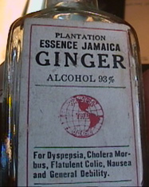
Organic Phosphorus Compound-Induced Delayed Neuropathy
Peripheral neuropathy from OP inhibition of nervous tissue enzyme
Many outbreaks worldwide
  Contaminated “supplement” in 1930s USA
  Contaminated cooking in mineral oils in Vietnam and Sri Lanka
Notes:
They other delayed syndrome to know about it the organic phosphorus compound-induced delayed neuropathy (or OPIDN). This delayed peripheral neuropathy is due to the organophosphate inhibiting important esterases in the nervous tissue. The most famous outbreak of this neuropathy in the United States occurred during Prohibition when the adulterant tricresyl phosphate or TOCP was added to an alcohol elixir. Thousands of people were exposed and developed a characteristic “Jake walk” from the peripheral neuropathy and foot drop that they developed. There have been many other intermittent outbreaks through out history, usually of contaminated cooking oils, with the most recent being in Vietnam and Sri Lanka.

Slide 22
How to diagnose toxicity
Most will have pinpoint pupils, excessive sweating, and difficulty breathing
Can test blood and urine for organophosphates assay – but often available and not timely
Best to test cholinesterase activity
Notes:
Now in terms of diagnosis, like most of other parts of medicine, we will be best served using our history and physical. Clearly we should have a very high index of suspicion for any patient with pinpoint pupils, excessive sweating and difficulty breathing and bronchorrhea. However, other times, it may not be that obvious and doing more testing is necessary. At our hospital we cannot get quick turn around times on any organophosphate concentrations or metabolites. Can you get these levels quickly? The second best thing to test is the activity of the actual cholinesterase itself and we can talk a little bit more about that here.

Slide 23
Cholinesterase Activity
Very difficult to test for AChE activity so we test using other surrogate esterases
Butyrylcholinesterase (plasma cholinesterase)
RBC acetylcholinesterase
Notes:
The actual acetylcholinesterase is available in the blood only in very minute quantities and thus we have to test for surrogate esterases. The two best and tesable esterases are butyrylcholinesterase which also goes by the name plasma cholinesterase and then the RBC acetylcholinesterase. We’ll talk a little about the pros and cons of both of these.

Slide 24
Cholinesterase Activity
 | Red Blood Cell Acetylcholinesterase | Butyrylcholinesterase
Advantage | Better reflection of synaptic inhibition | Easier to assay, declines faster
Site | RBC (reflects CNS gray matter, motor end plate) | CNS white matter, plasma, liver, pancreas, heart
Regeneration (untreated) | 1%/day | 25%–30% in first 7–10 days
Normalization (untreated) | 35–100 days | 28–42 days
Use | Unsuspected prior exposure with normal butyrylcholinesterase | Acute exposure
False depression | Pernicious anemia, hemoglobinopathies, antimalarial treatment, oxalate blood tubes | Liver dysfunction, malnutrition, hypersensitivity reactions, drugs (succinylcholine, codeine, morphine), pregnancy, or deficiency
Notes:
Here you can the main differences between the two tests. You can use either tests, but we are often times ordering the RBC acetylcholinesterase levels as this is a better reflection of the ACh enzyme activity at the synapse. It however, takes a long time to regenerate (up to the life of the RBC), and thus you can be sending somebody home with an abnormally depressed level. The plasma cholinesterase on the other hand does decline faster, but has more false negatives and false positives than does the RBC acetylcholinesterase.

Slide 25
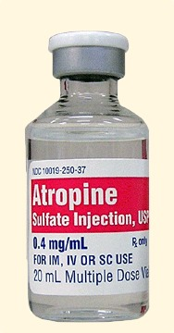
Atropine Challenge
1mg of atropine should produce tachycardia, mydriasis, and dry membranes
Persistence of cholinergic signs strongly suggest anticholinergic poisoning
Note: some mild toxicity may respond to this dose of atropine
Notes:
While the enzyme activity level tests may not have a quick turnaround, a simple test you can do at the bedside is the atropine challenge test. For anybody with a high suspicion of cholinergic toxicity, you can give a 1mg test dose of atropine. For you or I, 1 mg of atropine would lead to tachycardia, mydriasis, and dry mucous membranes. However, in a poisoned patient, they are likely to have ongoing cholinergic signs and thus would be considered a positive test. It is therefore a test with high specificity, but not very sensitive in the case of mild poisoning.

Slide 26
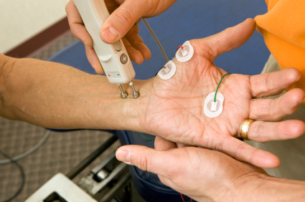
Electromyogram (EMG) Studies
Spontaneous repetitive potentials or fasciculations after single-nerve stimulation can be a sensitive indicator of AChE inhibition
Also useful in early detection of rebound cholinergic crisis/intermediate syndrome
Notes:
Another possible diagnostic test at our disposal is the electromyogram or EMG. Given the increased amount of acetylcholine at the neuromuscular junction, spontaneous repetitive action potentials or fasiculations after just a single nerve stimulation is quite sensitive for AChE inhibition. Because it is a quite sensitive test, it has found utility in the early detection of rebound cholinergic crisis or the intermediate syndrome that we have described earlier.

Slide 27
Management ABC’s
Airway
  Early intubation to prevent aspiration
Breathing
  Positive pressure ventilation given loss of respiratory muscles and drive
  Atropine to reverse bronchorrhea and bronchospasm
Circulation
  Atropine, IV fluid, and vasopressors for hypotension and bradycardia
Notes:
So those are our basic diagnostic tools that we have. But now let’s move on to the more fun stuff and how we are going to manaage these patients at the bedside. Organophosphate poisoned patients have derangements of their ABCs that must be addressed. Early airway management is important to prevent aspiration and given the risk of CNS and respiratory depression. Once severely poisoned, they will need positive pressure given the loss of drive and the muscle paralysis. Additionally, as we will talk about, atropine should be used to a goal of reversing the bronchorrhea and spasm. Cardiovascularly, these patients will be bradycardic and hypotensive and generally respond to atropine, IV fluids, and vasopressors if needed.

Slide 28
Goal of “Atropinization”
Aim to reverse bronchorrhea, bronchospasm
Systolic BP>90 and HR>80
Achieve this with incremental dosing
  Start with 1.5 to 3mg of atropine
  Double the dose every 5 min until above goals met
Once atropinization: atropine infusion at 10-20% of total loading dose per hour (max 2mg/hr)
Notes:
So as we mentioned, atropine is going to be our go-to treatment modality. Our goal with atropine is to reverse the bronchorrhea which is the most common cause of death. Additionally, you can set artificial vital sign cut offs, such as a BP of 90 and HR of 80, but these are really secondary to the bronchorrhea. What we recommend for atropine dosing is to start with 1.5 to 3mg. From there we recommned doubling the dose every 5 minutes until you reach our goals of atropinization. Once you get the patient there, you can switch over to an infusion, which is usually set at 10-20% of the total loading dose, but max’ing out at 2mg/hr.

Slide 29
Incremental Dosing
Incremental dosing compared to bolus dosing lead to:
  Faster time to atropinization
  Less atropine toxicity
  Less intermediate syndrome
  Lower mortality rate
Case reports of over 1000mg in 1st 24hrs
Incremental dosing
Bolus dosing
J Med Toxicol. 2012;8(2):108-117
Notes:
There have been studies done comparing this incremental dose doubling with intermittent bolusing. The dose double, as you can see here lead to a quicker time to atropinization and less atropine toxicity. Interestingly, it also lead to a lower rate of intermediate syndrome, and most importantly lead to a lower mortality rate compared to the intermittent bolusing. And you can see here, that these treatment regimens have required up to 1000mg of atropine! Have you seen this happen? Would you have enough atropine? Or know where to get it from?

Slide 30
And if you run out of atropine?
Other antimuscarinic drugs can potentially help in the absence of atropine:
  Glycopyrrolate
  Scopolamine
  Diphenhydramine
Notes:
Because a lot of hospitals won’t have 1000mg of atropine, let alone 10 or 20mg, it is important to know that other antimuscarinic drugs have been used in the past in these scenarios. Glycopyrrolate is a peripheral acting agent and so will be great for reversing peripheral cholinergic findings but will not alter any other CNS toxicity. Scopolamine and diphenhydramine are both potent central and peripheral antimuscarinic agents and could potentially be used if atropine is unavailable.

Slide 31

Atropine does nothing to reverse nicotinic neuromuscular junction stimulation (paralysis)
Even if bronchorrhea, bronchospasm, bradycardia are controlled patient needs to be intensively monitored for respiratory failure
Notes:
The big take away point from this slide is that all the atropine and antimuscarinic agents can do nothing about the toxicity at the nicotinic neuromuscular junction. Thus atropine will NOT reverse the OP-induced paralysis and so these patients often require intubation and intensive monitoring for respiratory failure even if the bronchorrhea, bronchospasm, and bradycardia have been controlled.

Slide 32
What can reverse the paralytic effects…maybe?
Oximes (pralidoxime in the US, obidoxime or others elsewhere)
  The theory: able to regenerate AChE if given prior to enzyme ageing
Notes:
So we have something to treat the bronchorrhea and bradycardia in atropine. Now, do we have something to treat the paralysis and can we some how regenerate the acetylcholinesterase. The answer may lie in oximes. In the US we given pralidoxine or 2-PAM. In other countries they given obidoxime or several others. Do you know which one you use here in Thailand or any at all?
The basic theory behind the oxime is that is regenerates the ACh enzyme prior to the enzyme ageing like we were talking about before. Here you can see the reaction, the oxime on the left, attacking the OP-Ach enzympe complex and ultimately releasing the free AchE enzyme to metabolism acetylcholine.

Slide 33
Why the maybe?
Several Sri Lanka studies have shown no benefit from pralidoxime or even a trend toward harm
  ??dose insufficient ??low level of supportive care
Cochrane review concluded current evidence is insufficient to indicate harm or benefit from oximes
Very limited data on other oximes
Notes:
So why did I write maybe on that last slide. Well actually several studies mainly out of Sri Lanka have shown no benefit from pralidoxime and even a trend toward harm at times. Critics of these conclusions have often cited that the pralidoxime dose was rather small and they have poor supportive care. However, additionally a cochrane review was also published saying their is not enough info to correlate oximes with a harm or benefit. The other oximes have been even less characterized in the literature. It should also be noted here that oximes are ineffective and unnecessary for carbamate pesticides given their spontaneous regeneration of the acetylcholinesterase.

Slide 34
Oximes
Exact role is currently unclear
Should be given as soon as possible after exposure to increase chance of benefit
Continue until sustained electrophysiologic or clinical improvement documented
High quality supportive care most important
Notes:
So, I think worldwide, there is still a little uncertainty as to the exact role of oximes, but in organophosphate poisoning we are still recommending it at this time in the United States. With the caveat that it should be given as soon as possible after the exposure and then continued until some marker of clinical or electrophysiologic improvement can be documented. And then remembering that oximes are no substitution for high quality supportive care.

Slide 35
Future Treatment/Research Areas
Magnesium or clonidine therapy to reduce presynaptic acetylcholine release
Fresh frozen plasma as a butyrlcholinesterase source to scavenge OP pesticides
Sodium bicarbonate for serum alkalinization
Notes:
So for now we have atropine and then oximes for organophosphates. There are some interesting studies out there looking some alternatives and adjunct therapy. Both magnesium and clonidine are known to decrease the amount of acetylcholine release. Giving these could potentially decrease the massive amount of Ach at the nerve terminal and stem some toxicity. Additionally FFP has been tried as a source of plasma cholinesterase to “chelate the organophospate” if you well. And then lastly sodium bicarb has been given to change the distribution and metabolism of individual organophosphates. However, none of these adjunct treatments are being recommened at this time. Are you using any adjunct treatments for an organophosphate poisoning?

Slide 36
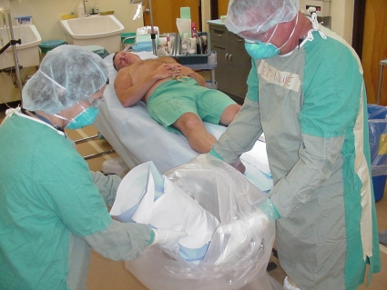
Decontamination
Standard universal precautions
Vomitus, diarrhea, body fluids may be contaminated
Skin and clothing notoriously difficult to decon
  Triple wash with soap and wash
  Military has experimented with cholinesterase sponges
NG lavage and activated charcoal if airway protected and present early
Notes:
And now just a few words on decontamination before we wrap things up. Like I mentioned previously, dermal absorption can be quite good, and coupled that with the fact that skin and clothing is very difficult to decon - it is recommended to triple wash with soap and water. The military has experimented with cholinesterase sponges - I’m not sure if those would be availabe in Thailand or not. It you get the patient early and have the airway protected, NG lavage and acitvated charcoal are resonable given the high morbitity and mortality of large ingestions.

Slide 37
Disposition
RBC AChE may remain low at discharge
  remains depressed long after neuronal AChE regenerated
Ok to discharge after asymptomatic and not requiring pralidoxime or atropine for 1 to 2 days
  Rare case reports of recurrent cholinergic crisis and/or respiratory failure after several days
  No case reports of carbamates with recurrent or delayed poisoning
Notes:
Lastly, we need to know who to send home and who we need to keep in the hospital. As we mentioned earlier, the acetylcholinesterase activity test level may remain low for some time despite the patient improving clinically. It is documented in the literature, that it is likely safe to discharge a patient that is now asymptomatic, and has not required pralidoxime or atropine in 48hours. Even doing this, there has been rare case reports of delayed toxicity beyond this. When dealing with a carbamate, you do not have to worry about this, given the lack of any cases or mechanism for delayed toxicity.

Slide 38
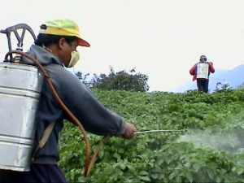
Organophosphate and Carbamates
Rapid decontamination
Early airway protection
Rapid atropinization
+/- oxime therapy
Intensive monitoring
for delayed sequelae
Notes:
So in summary organophosphates are a huge problem worldwide that may be helped with increased regulation. The goals of therapy are rapid decontamination, early airway protection, rapid atropinization with doubling the dose of atropine and plus minus using an oxime to regenerate the acetylcholinesterase. And then finally intensive monitoring for delayed sequale.

Slide 39
Questions…??

